Slide 1
Data Visualization of Bird Strikes between 2000 – 2011
Aditya Sinha

Slide 2
Introduction
This report analyses bird strike incidents involving aircraft which focuses on various aspects such as the timing, altitude, impact on flights, and whether pilots were informed about the potential presence of wildlife. The data used in this report encompasses multiple variables related to bird strikes, providing insights into patterns and consequences.

Slide 3
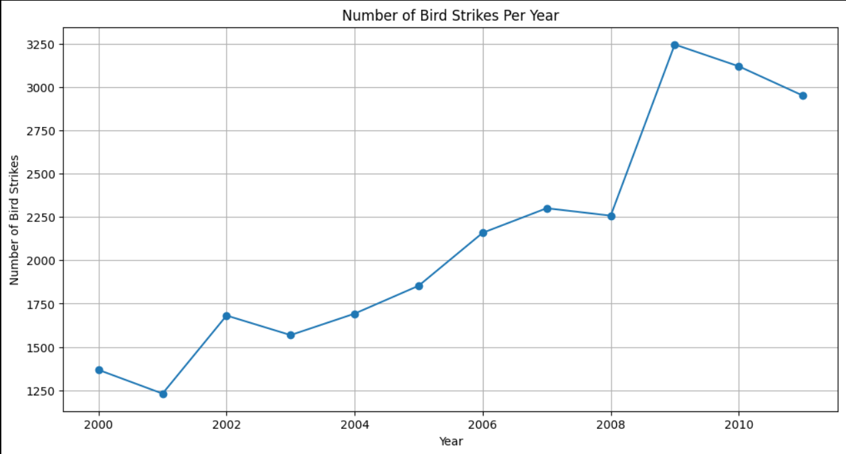
Yearly Analysis of Bird Strikes
Observation:
The number of bird strikes generally increased from 2000 to 2011, with a notable spike in 2009.

Slide 4
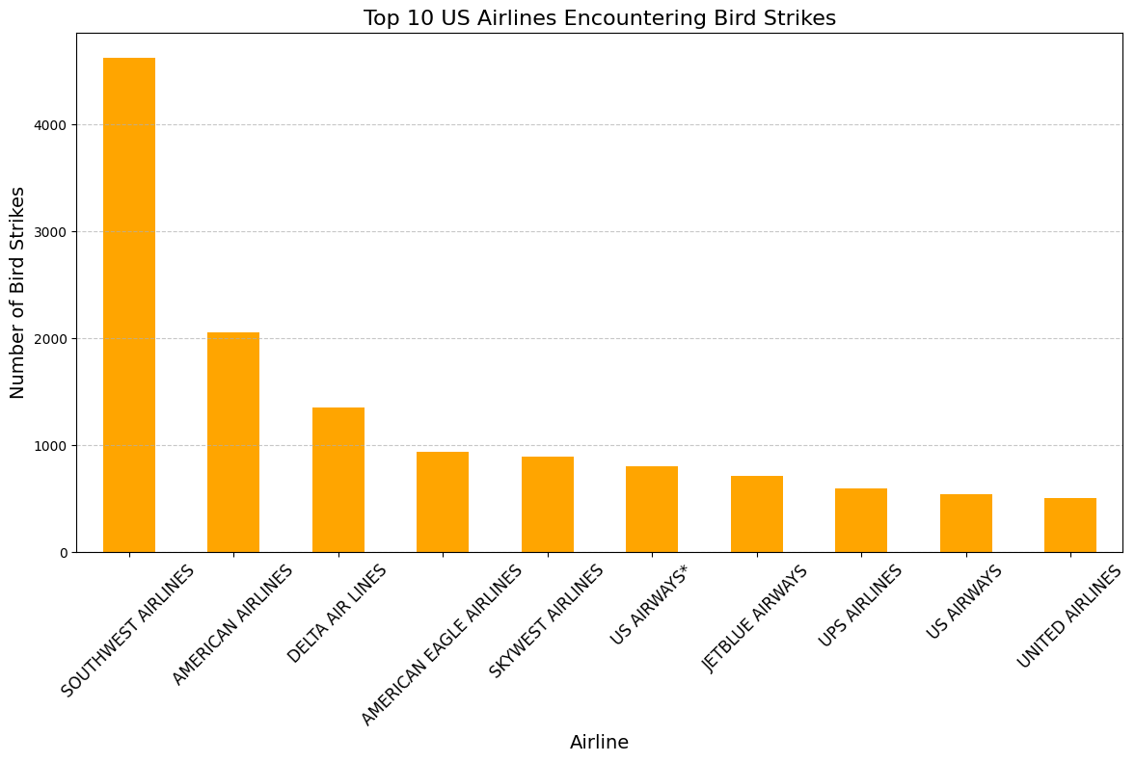
Top US Airlines Encountering Bird Strikes
Southwest Airlines: 4628 bird strikes
American Airlines: 2058 bird strikes
Delta Air Lines: 1349 bird strikes
American Eagle Airlines: 932 bird strikes
SkyWest Airlines: 891 bird strikes
US Airways*: 797 bird strikes
JetBlue Airways: 708 bird strikes
UPS Airlines: 590 bird strikes
US Airways: 540 bird strikes
United Airlines: 506 bird strikes

Slide 5
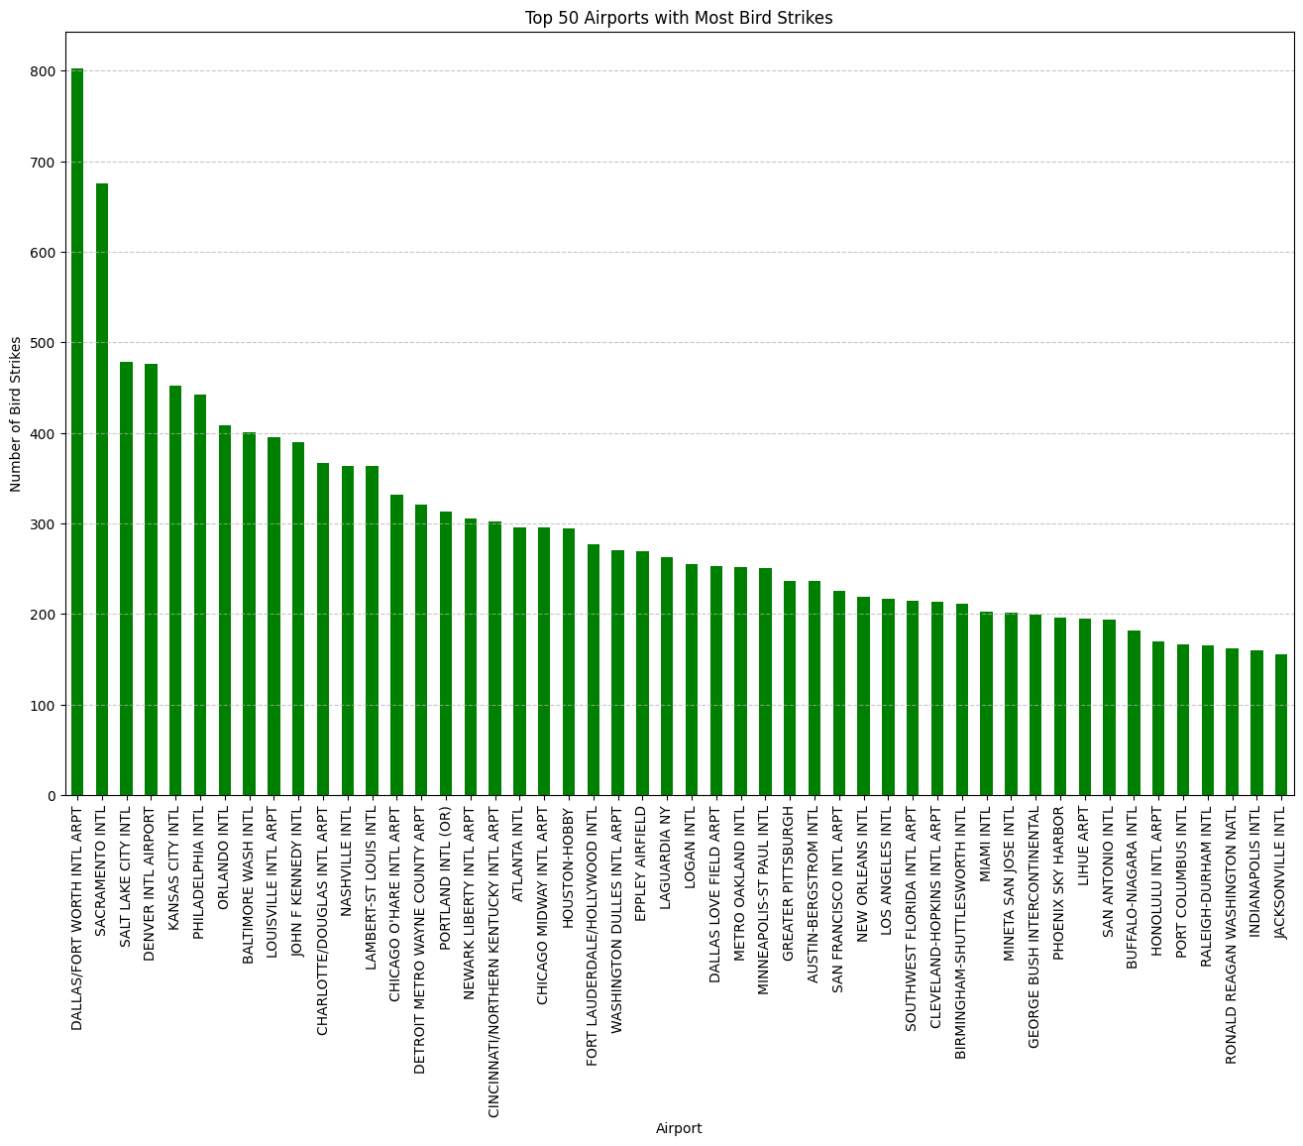
Top Airports with Bird Strikes
Dallas/Fort Worth Intl Arpt: 803 bird strikes
Sacramento Intl: 676 bird strikes
Salt Lake City Intl: 479 bird strikes
Denver Intl Airport: 476 bird strikes
Kansas City Intl: 452 bird strikes

Slide 6
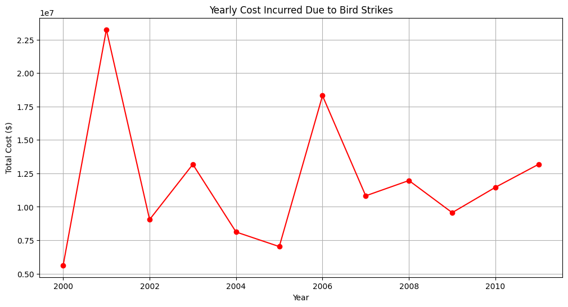
Yearly Cost Incurred Due to Bird Strikes
Observation: Yearly cost peaks at 2001, 2003,2006 with maximum in the year of 2001

Slide 7
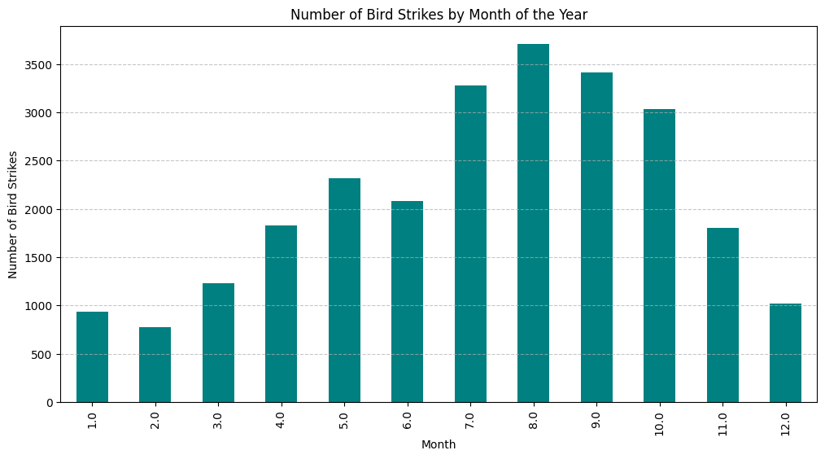
Timing of Bird Strikes
Bird strikes occur throughout the year with maximum in the month of July, August, September…

Slide 8
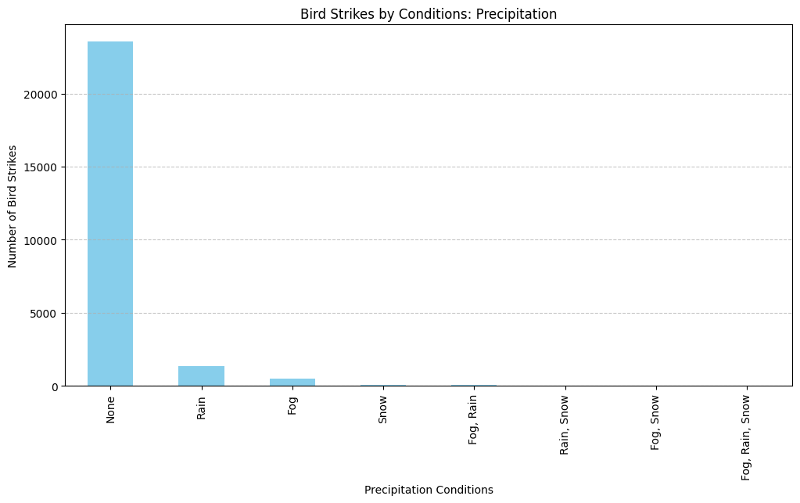
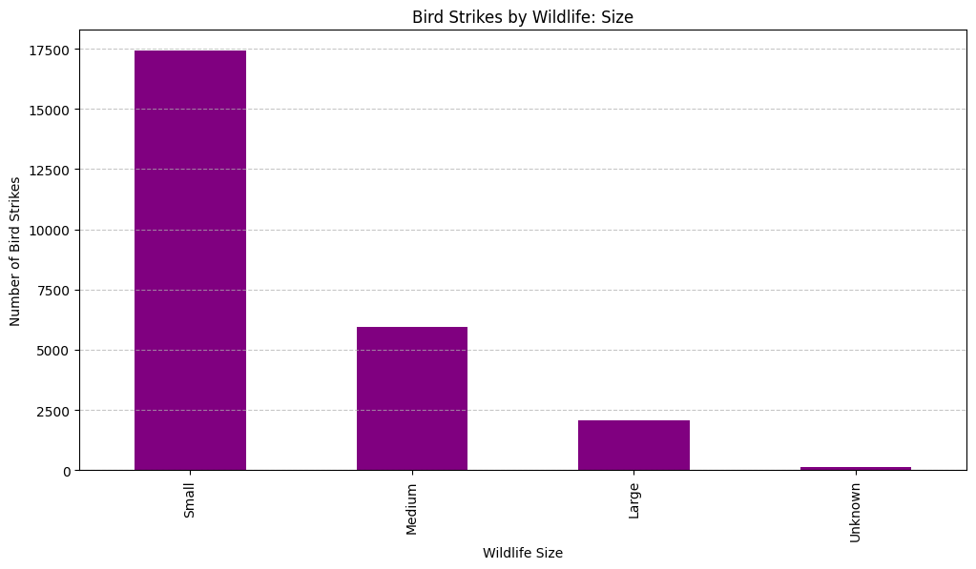
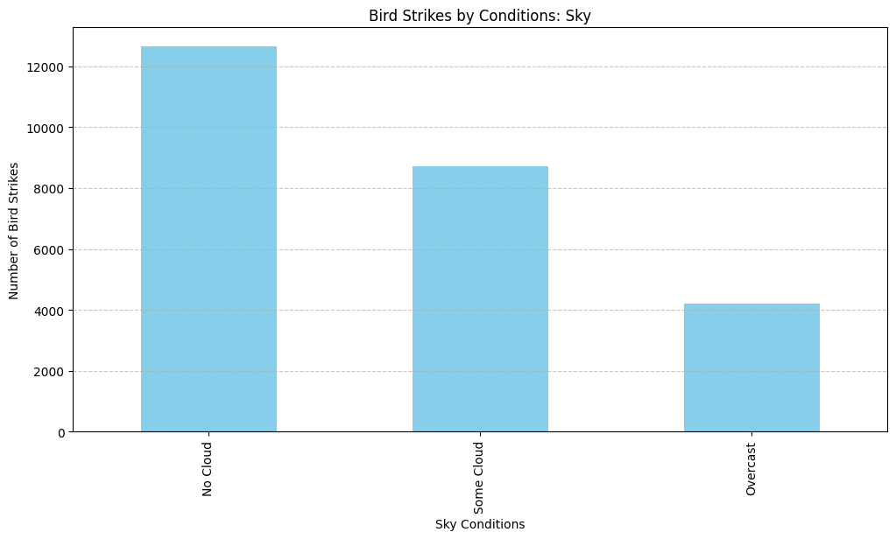
One Inference can be drawn from these 3 graphs is that most bird strikes occurs when weather is clear and size of flock of birds is relatively small.

Slide 9
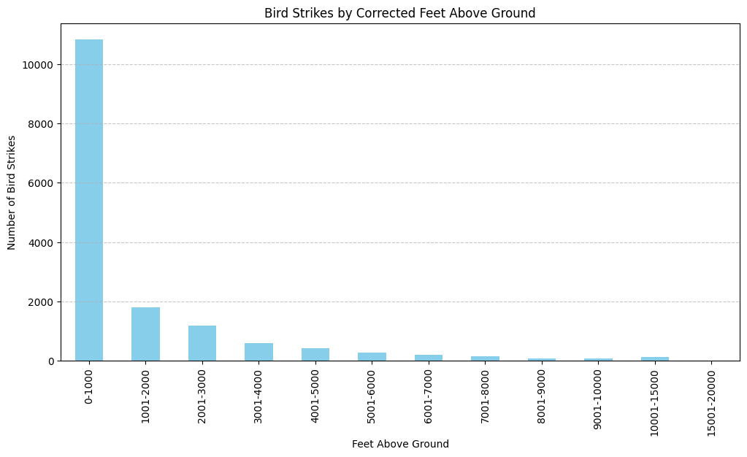
Altitude at the Time of Bird Strike
Most bird strikes occurs at the lower level of altitude (near 1000 feet above ground or lower)

Slide 10
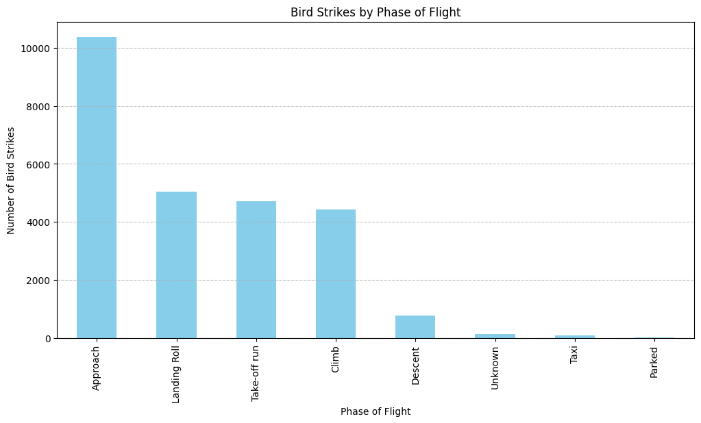
Phase of Flight at the Time of Strike
Most of the Bird Strikes occur during landing Approach, landing Roll, Take-off run, Climb with maximum during Approach (Low Altitude as observed in previous slide)

Slide 11
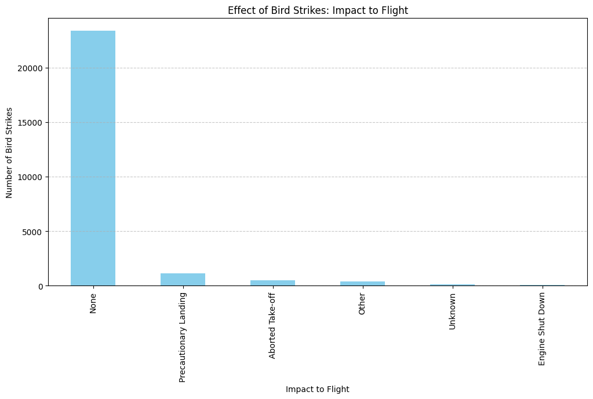
Effect of Bird Strikes & Impact on Flight
It can be observed that most of the Bird Strikes doesn’t affect the flight but some causes Precautinary landing and some causes serious damage to aircraft as it strikes resulted into Aborted Take-off

Slide 12
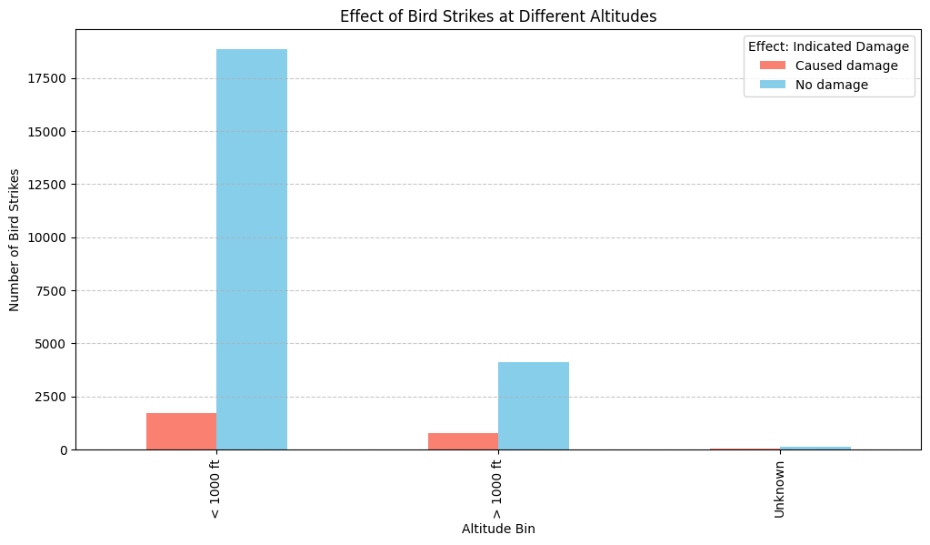
Effect of Strike at Different Altitudes
< 1000 ft:
Caused Damage: 1,702 incidents
No Damage: 18,854 incidents
1000 ft:
Caused Damage: 752 incidents
No Damage: 4,121 incidents

Slide 13
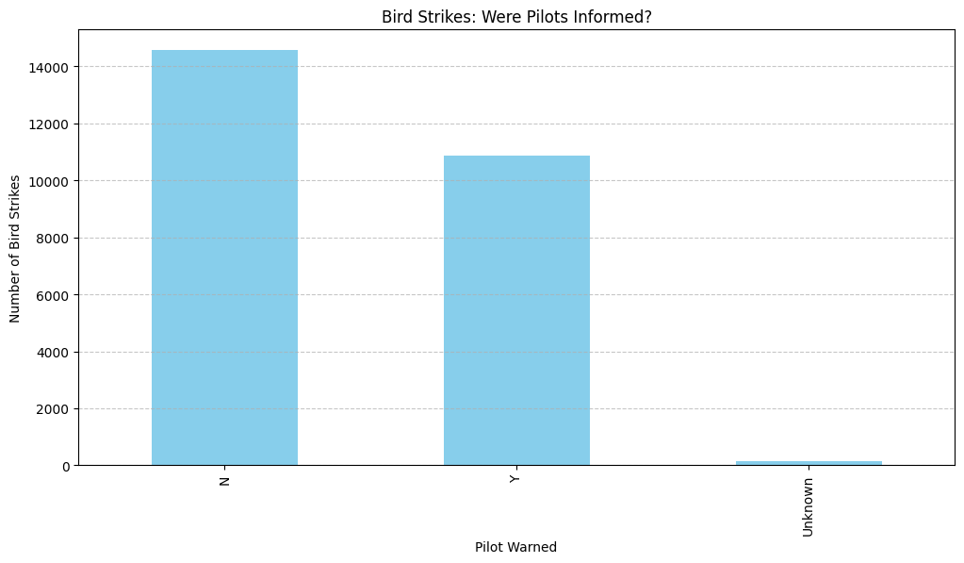
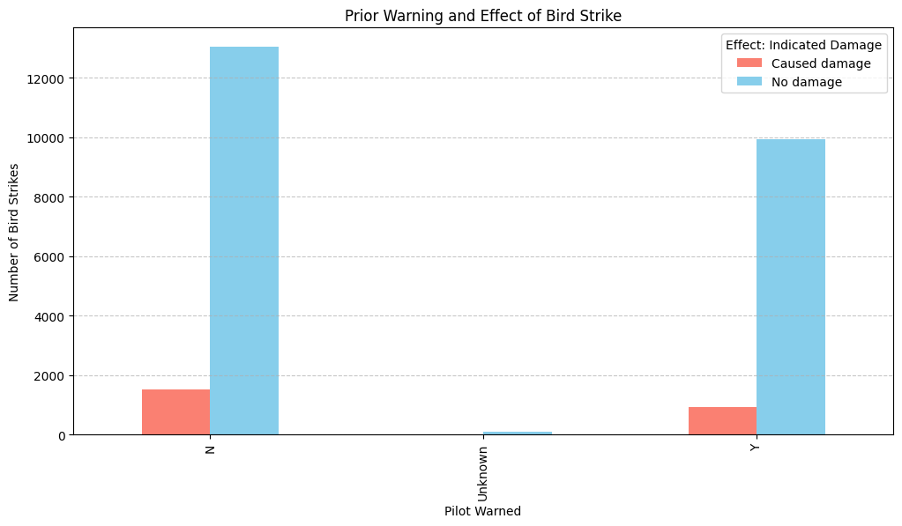
Pilot Information and Prior Warning
A larger number of bird strikes occur when pilots are not informed (14,567) compared to when they are informed (10,862).
When pilots are informed, there are fewer incidents causing damage (922) compared to when they are not informed (1,532).
In both cases, the majority of bird strikes do not cause damage, but being informed seems to correlate with a lower number of damage-causing incidents.

Slide 14
Conclusion
This report provides a comprehensive analysis of bird strikes involving aircraft, highlighting key patterns and impacts. Understanding these aspects can help in developing better strategies for mitigating bird strike risks and improving aviation safety.
THANK YOU!

